Slide 1

MARKETING CAMPAIGN
REPORT
BY
Neel Balar
14th July, 2023

Slide 2

OVERVIEW
In this report, we analyzed the factors that significantly impact web purchases, the most successful marketing campaign, the average customer profile, the best performing product, and the underperforming channel. Based on our analysis, we recommend certain actions to improve the performance of web purchases and increase revenue.
“Don’t find customers for products, find products for your customers.”

Slide 3


METHODOLOGY
Understand the data.
Clean the data.
Organize the data
Data analysis.
Conclusion.

Slide 4

GOALS
Identify customer background.
Generate leads and increase sales.
Enhance brand reputation.
Support specific business objectives.
Understand customers’ requirements.
Analyze business strategy.

Slide 5

KPIs
Customer’s age
Education
Marital status
Income
Amount spent on different products
Different campaign channels
Date of customers’ enrollment to the company.

Slide 6

SUM, AVERAGE, ROUND, COUNT,TEXT, MODE formulas
Formatting, Sorting.
Pivot Tables
Charts
Concepts Used

Slide 7

ANALYSIS
“The core advantage of data is that it tells you something about the world that you didn’t know before.”

Slide 8
Are there any null values or outliers? How will you handle them?
There is total 24 NULL values in field 'Income' and 1 Outlier.
So, replace these 25 values with Mean=51973.
There is total 3 Outliers in 'Year_Birth' field.
So, replace these 3 values with Mode.

Slide 9
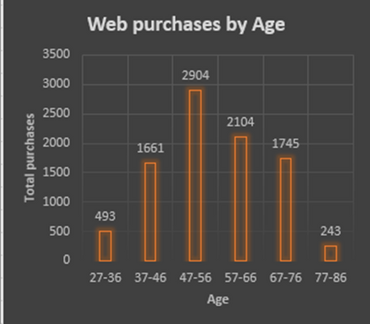
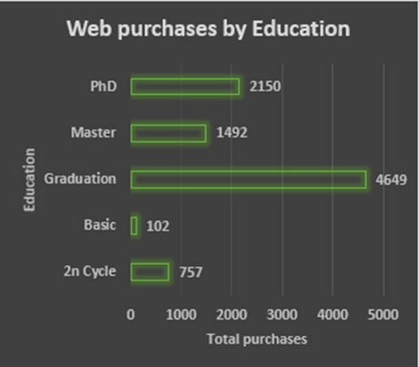
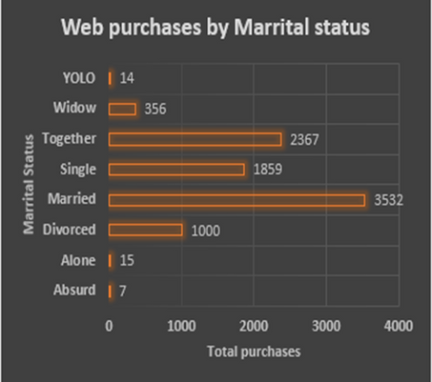
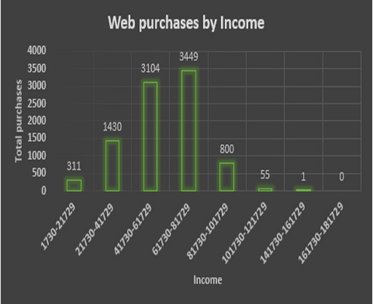
What factors are significantly related to the number of web purchases?
Birth Years, Education, Marital and Income factors are significantly related to the
number of purchases.

Slide 10
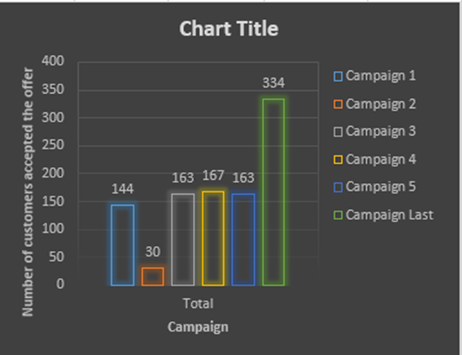
Which marketing campaign was the most successful?
Last campaign was the most successful.

Slide 11
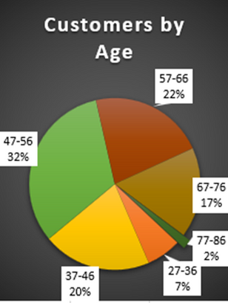
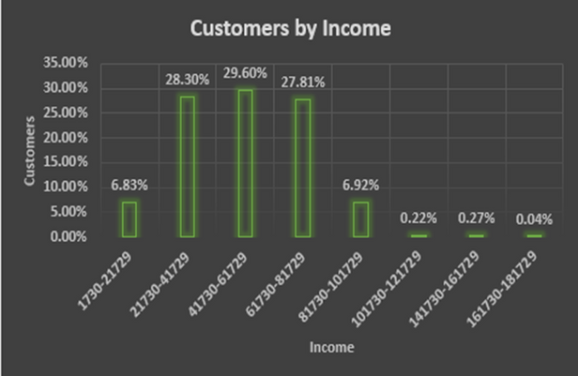
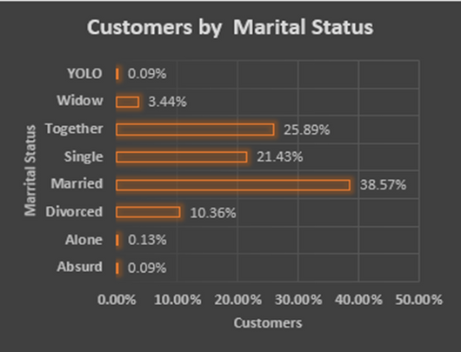
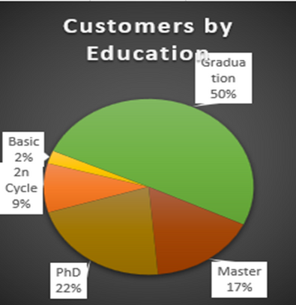
What does the average customer look like?
An average customer is look like age between 47-56, Graduated, Married and having income between 21730 to 81729.

Slide 12
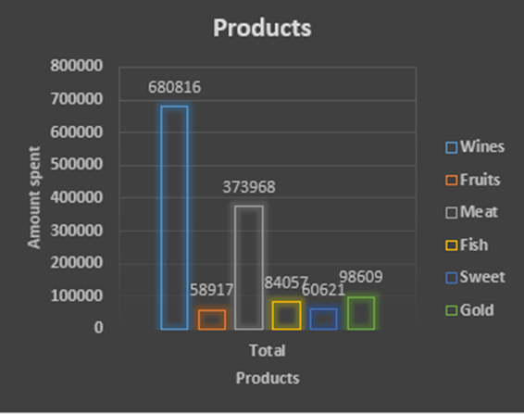
Which products are performing best?
"Wine" is the best performing product.

Slide 13
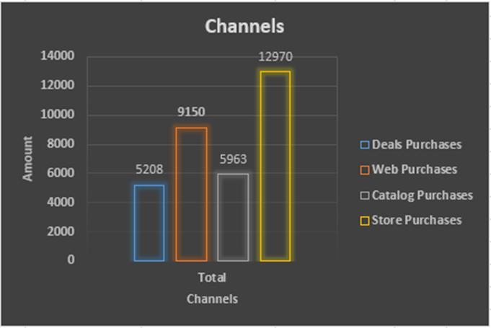
Which channels are underperforming?
"Deal" channel is underperforming while "Store" channel is best performing.

Slide 14

CONCLUSION
In conclusion, by understanding the factors that influence web purchases, focusing on the best-performing products, and improving the customer experience, companies can increase revenue and improve the performance of different purchases. With the right strategies and tactics, Store purchases can become a significant source of revenue and growth for the company.

Slide 15


THANK YOU

